Slide 1
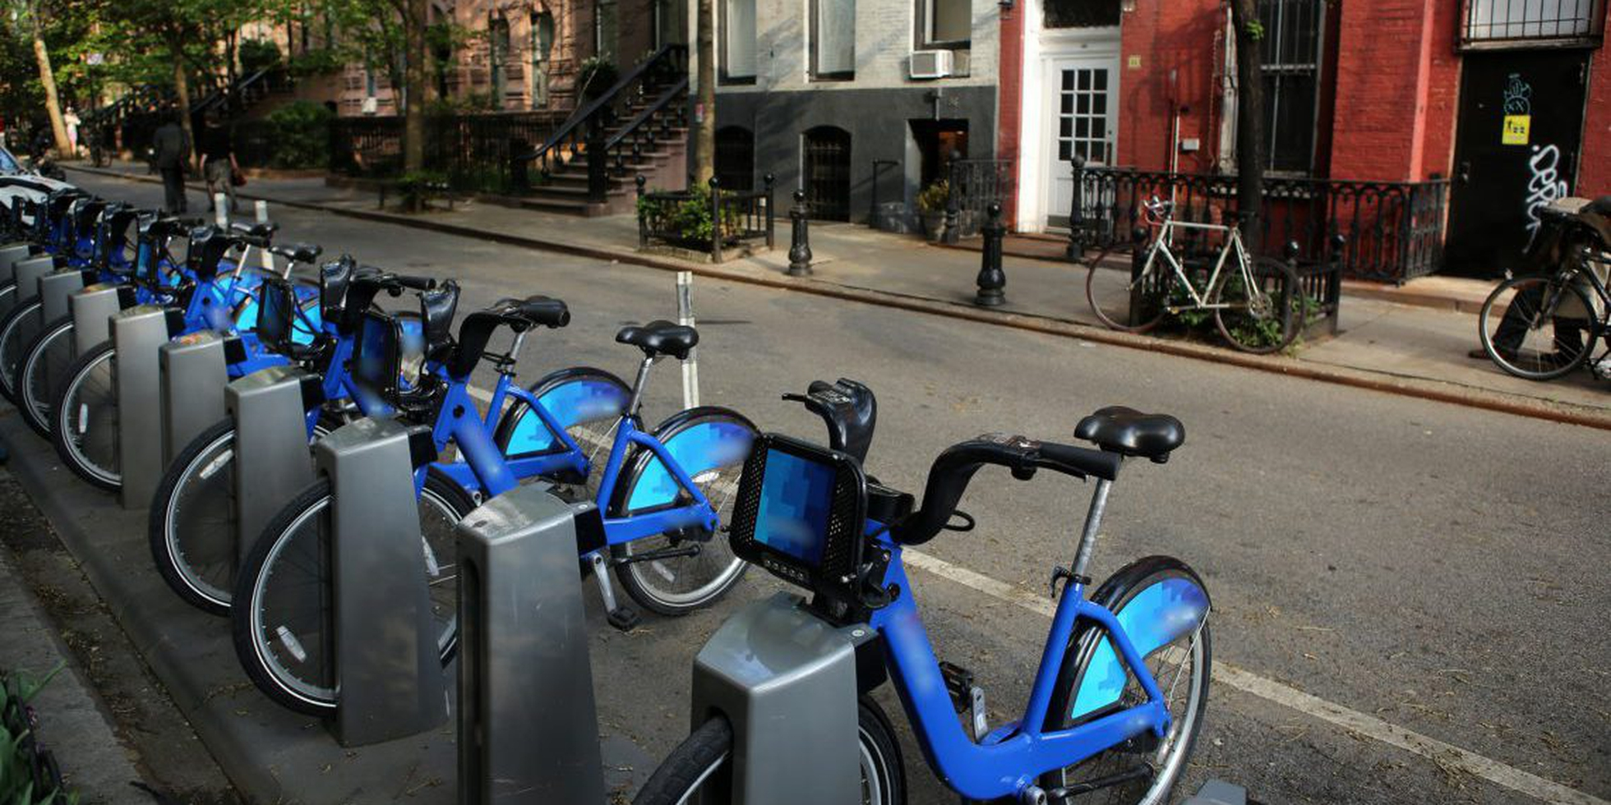
Cyclistic Bike Trip Presentation
An in-depth analysis of how customer use the bike-share service
Presented by: Viet Pham

Slide 2
Table Of Contents:
Project Overview
Data and Analysis (Conclusions/Recommendations)
Dashboard Reference

Slide 3
Project Overview
Cyclistic has partnered with the city of New York to provide shared bikes for customers to travel throughout Manhattan and neighboring boroughs. The Customer Growth Team wants to understand how their customers are using their bikes; their top priority is identifying customer demand at different station locations, as well as relevant information.
How can the team apply customer usage insights to inform new station growth to alleviate demand in different geographical areas?

Slide 4



Dashboard Key Insights
Understand how different locations affect the bike using
How do different users (subscriber and non-subscriber/
customer) use the bike service ?
Bike using trends year over year

Slide 5
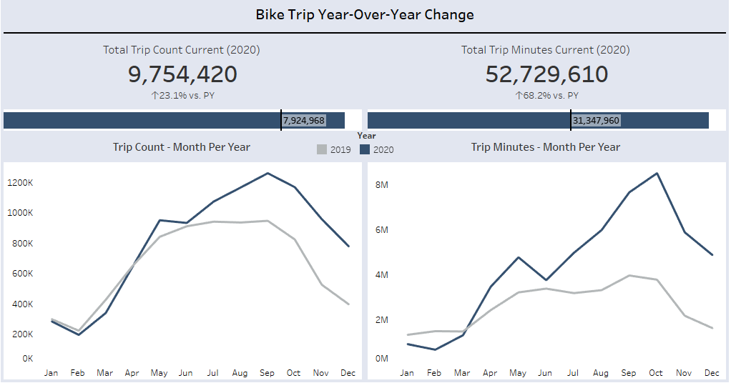
Higher frequency
Seasonality
Inform on bike maintenance in months with lower bike usage to prepare for months with higher bike usage
Peak (summer ended)
High travelling time
(even though in the mid of COVID)
Gradually decrease (approaching weather months)
Dip (due to weather)
The demand increased after Q1

Slide 6
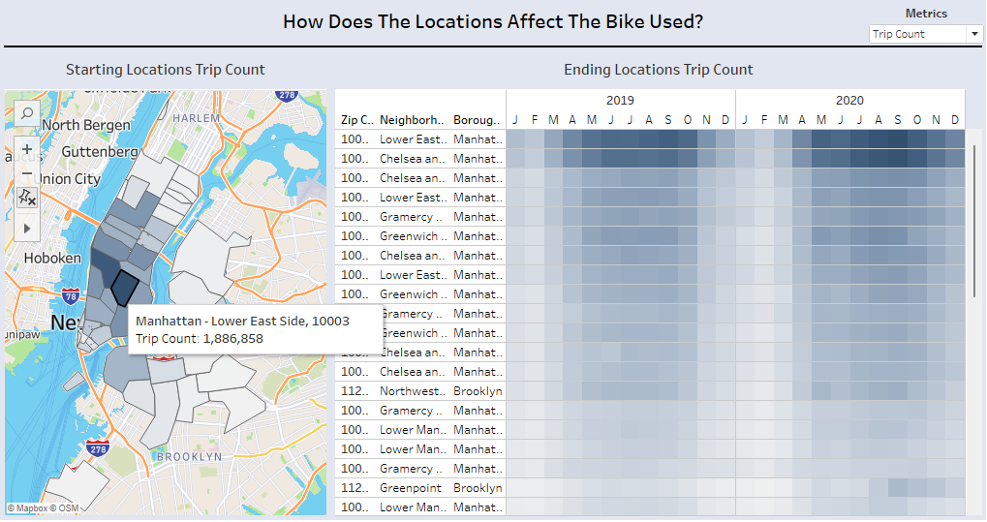
Lower East Side & Chelsea and Clinton gained the most popularity that customers travelling back and forth (entertainment, cuisine, shopping places, and so on )

Slide 7
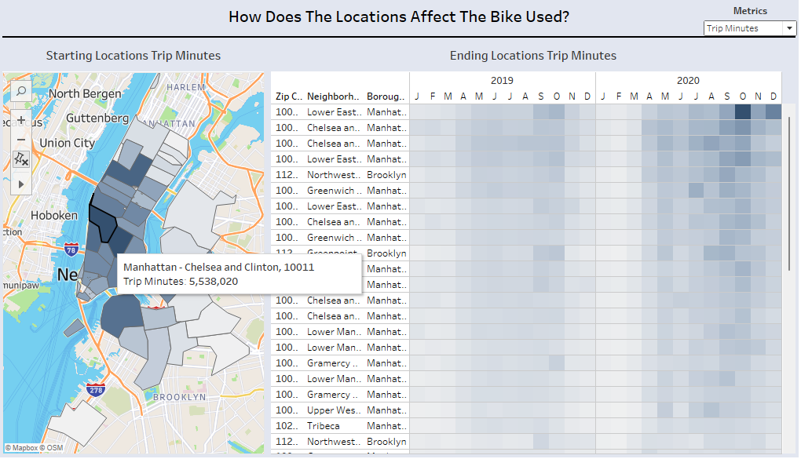
Could inform in the new station growth in these places to address customer need.

Slide 8
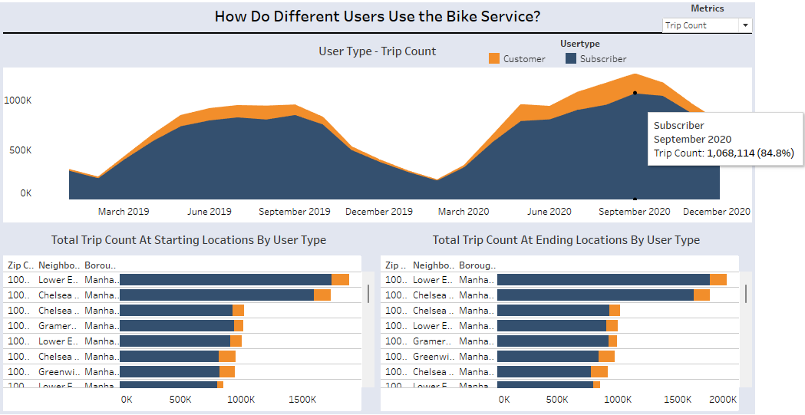
Trends about seasonality and most visited places also applied to the user type.
The majority in number of trips from Subscriber (80-90%)
of trips (80-90%)

Slide 9
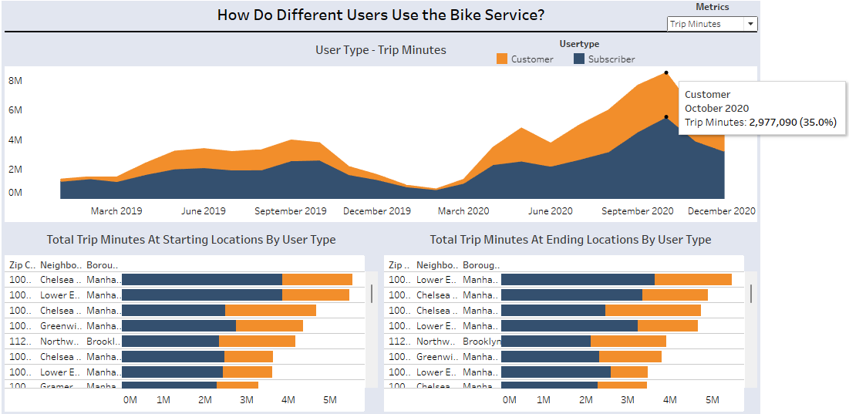
30-40% frequency in time travelling for non-subscriber during peak months.
Deploy marketing strategies to convert non-subscriber become subscriber (around after Q1)

Slide 10
Dashboard Reference:
Bike | Tableau Public

Slide 11
THANK YOU

